Slide 1
CHAPTER 7: DESIGN A UNIQUE ID GENERATOR IN DISTRIBUTED SYSTEMS
2024-02-27

Slide 2
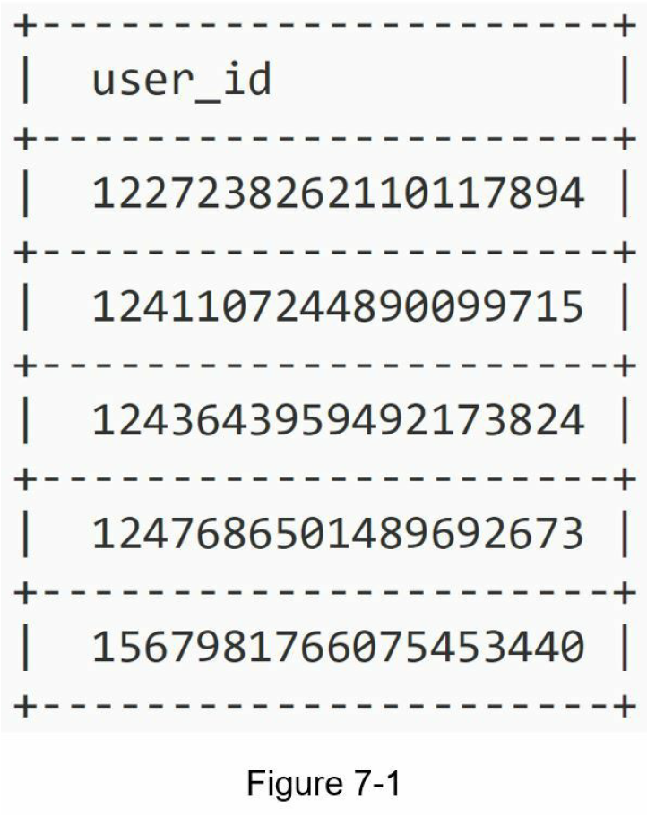
Step 0 – Introduction
Your first thought might be to use a primary key with the auto_increment attribute in a traditional database.
However, auto_increment does not work in a distributed environment
because a single database server is not large enough and generating unique IDs across multiple databases with minimal delay is challenging.

Slide 3
Step 1 - Understand the problem and establish design scope
Candidate: What are the characteristics of unique IDs?
Interviewer: IDs must be unique and sortable.
Candidate: For each new record, does ID increment by 1?
Interviewer: The ID increments by time but not necessarily only increments by 1. IDs created in the evening are larger than those created in the morning on the same day.
Candidate: Do IDs only contain numerical values?
Interviewer: Yes, that is correct.
Candidate: What is the ID length requirement?
Interviewer: IDs should fit into 64-bit.
Candidate: What is the scale of the system?
Interviewer: The system should be able to generate 10,000 IDs per second.
For this interview question, the requirements are listed as follows:
IDs must be unique.
IDs are numerical values only.
IDs fit into 64-bit.
IDs are ordered by date.
Ability to generate over 10,000 unique IDs per second.

Slide 4
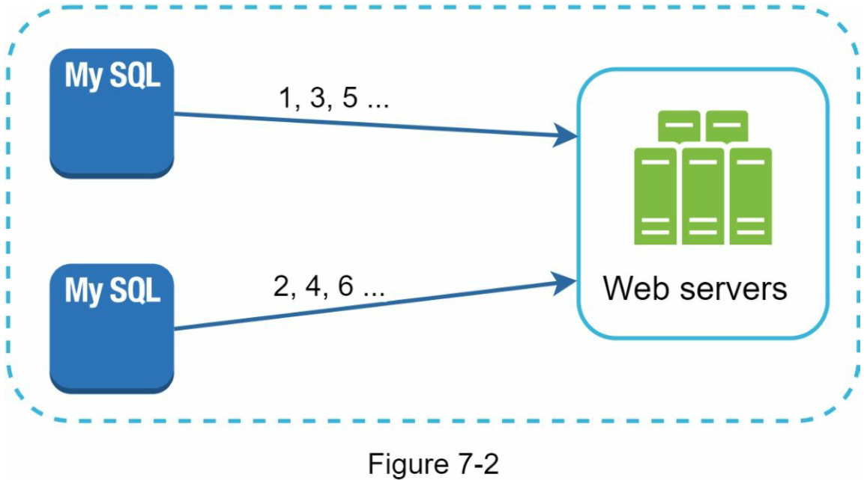
Step 2 - Propose high-level design and get buy-in
Multi-master replication
This approach uses the databases’ auto_increment feature.
Instead of increasing the next ID by 1, we increase it by k, where k is the number of database servers in use.
This solves some scalability issues because IDs can scale with the number of database servers.
However, this strategy has some major drawbacks:
Hard to scale with multiple data centers
IDs do not go up with time across multiple servers.
It does not scale well when a server is added or removed.

Slide 5
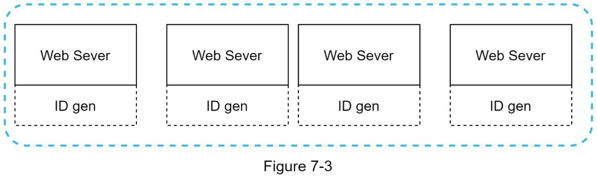
Step 2 - Propose high-level design and get buy-in
UUID
A UUID is another easy way to obtain unique IDs.
UUID is a 128-bit number used to identify information in computer systems.
UUID has a very low probability of getting collusion.
Quoted from Wikipedia, “after generating 1 billion UUIDs every second for approximately 100 years would the probability of creating a single duplicate reach 50%”.
Example of UUID: 09c93e62-50b4-468d-bf8a-c07e1040bfb2
UUIDs can be generated independently without coordination between servers.
In this design, each web server contains an ID generator, and a web server is responsible for generating IDs independently.
Pros:
Generating UUID is simple. No coordination between servers is needed so there will not be any synchronization issues.
The system is easy to scale because each web server is responsible for generating IDs they consume. ID generator can easily scale with web servers.
Cons:
IDs are 128 bits long, but our requirement is 64 bits.
IDs do not go up with time.
IDs could be non-numeric.

Slide 6
Step 2 - Propose high-level design and get buy-in
RFC 4122: A Universally Unique IDentifier (UUID) URN Namespace
xxxxxxxx-xxxx-Mxxx-Nxxx-xxxxxxxxxxxx
UUID는 16진수 값 (x) 의 문자열 형식으로 표현됩니다.
8-4-4-4-12의 다섯 그룹으로 이루어진 32개의 16진수 문자이며, 각 그룹은 하이픈(-)으로 구분
M은 UUID 버전
N의 상위 2비트 UUID의 variant
0b017903-5590-4c34-8a74-d1f113ac5
UUID의 대부분은 난수 생성기를 사용하여 총 128비트 중에서 122비트가 무작위로 선택됩니다.
13번째 자리의 4비트는 UUID 버전읠 의미합니다. 예제는 버전 4 UUID를 의미합니다.
17번째 자리의 상위 2비트는 UUID의 variant 을 의미합니다.
"variant"는 UUID가 어떻게 생성되었는지를 나타냅니다.
버전 4 UUID에서는 variant 비트가 10으로 설정됩니다.
10 비트 패턴은 해당 UUID가 랜덤하게 생성된다는 것을 나타내며, "variant" 중 하나인 "Leach-Salz variant” 입니다.

Slide 7
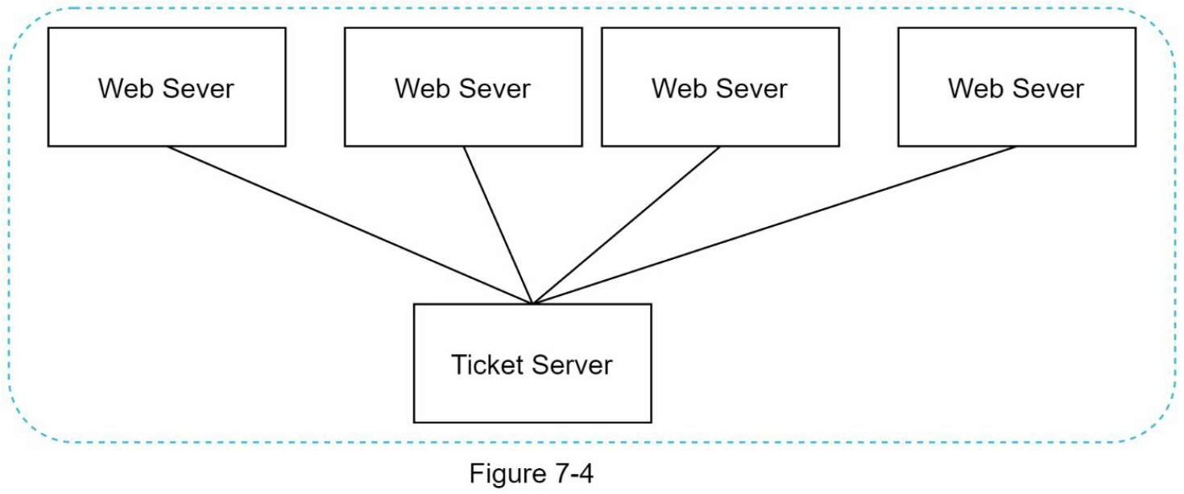
Step 2 - Propose high-level design and get buy-in
Ticket Server
Flicker developed ticket servers to generate distributed primary keys [2]. It is worth mentioning how the system works.
The idea is to use a centralized auto_increment feature in a single database server (Ticket Server).
Pros
Numeric IDs.
It is easy to implement, and it works for small to medium-scale applications.
Cons
Single point of failure. Single ticket server means if the ticket server goes down, all systems that depend on it will face issues.
To avoid a single point of failure, we can set up multiple ticket servers. However, this will introduce new challenges such as data synchronization.

Slide 8
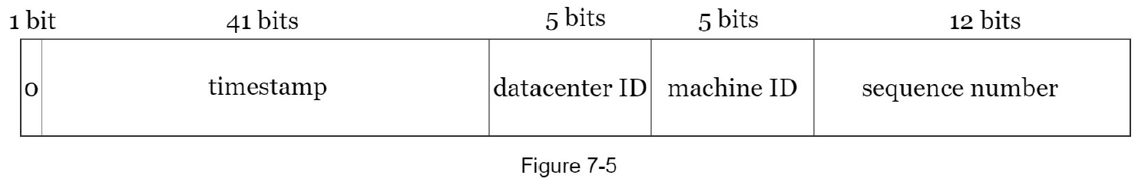
Step 2 - Propose high-level design and get buy-in
Twitter snowflake approach
Twitter’s unique ID generation system called “snowflake” [3] is inspiring and can satisfy our requirements.
Divide and conquer is our friend. Instead of generating an ID directly, we divide an ID into different sections.
Figure 7-5 shows the layout of a 64-bit ID.
Sign bit: 1 bit. It will always be 0.
This is reserved for future uses.
It can potentially be used to distinguish between signed and unsigned numbers.
Timestamp: 41 bits.
Milliseconds since the epoch or custom epoch.
We use Twitter snowflake default epoch 1288834974657, equivalent to Nov 04, 2010, 01:42:54 UTC.
Datacenter ID: 5 bits,
which gives us 2 ^ 5 = 32 datacenters.
Machine ID: 5 bits,
which gives us 2 ^ 5 = 32 machines per datacenter.
Sequence number: 12 bits.
For every ID generated on that machine/process, the sequence number is incremented by 1.
The number is reset to 0 every millisecond.

Slide 9
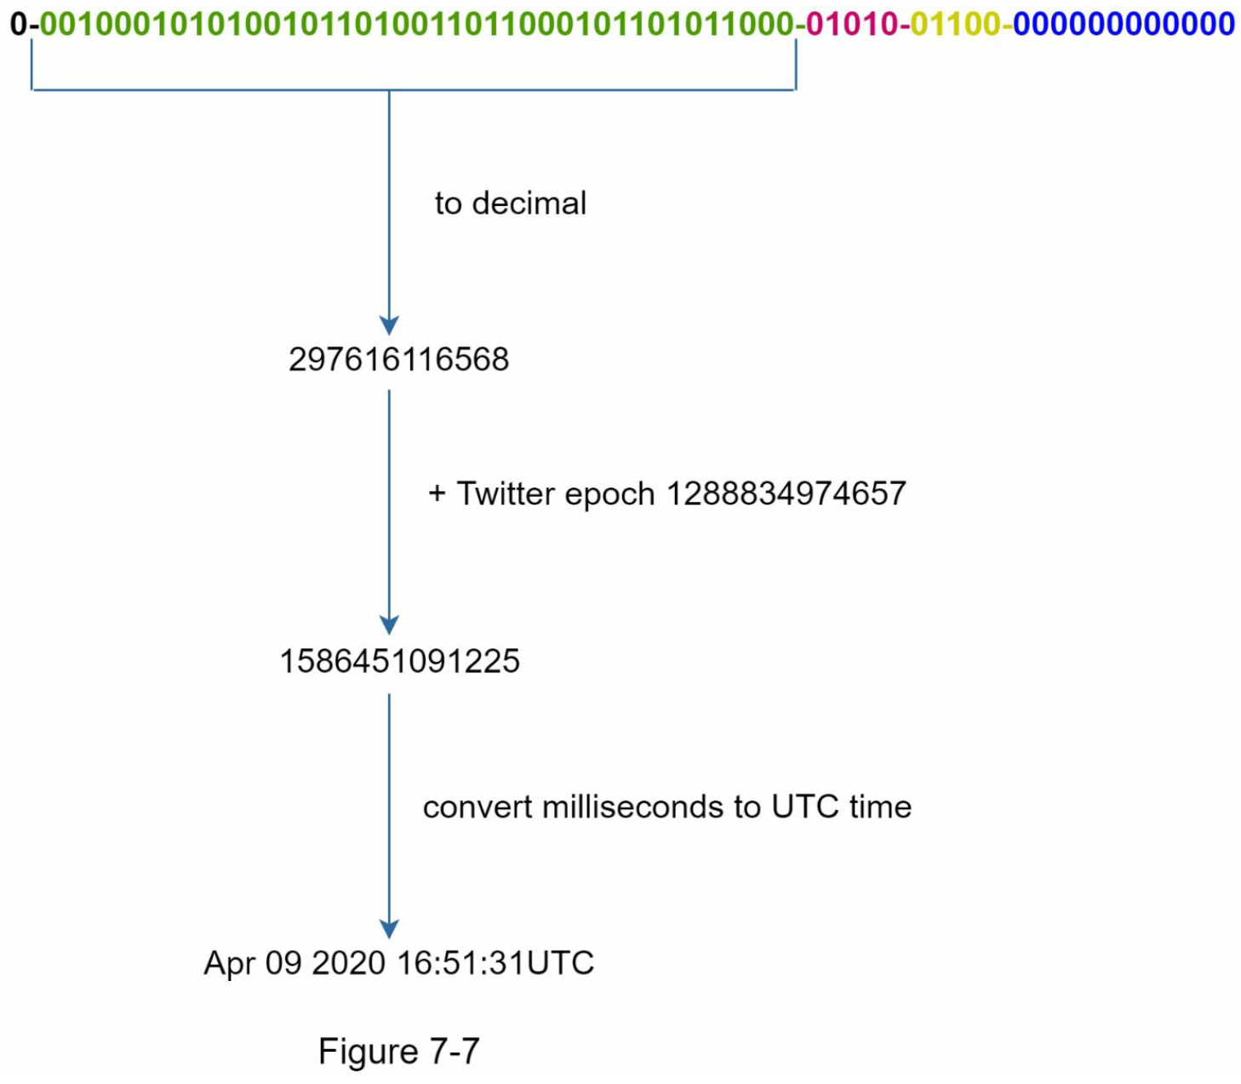
Step 3 - Design deep dive (Twitter snowflake approach)
Timestamp
The most important 41 bits make up the timestamp section.
As timestamps grow with time, IDs are sortable by time.
Figure 7-7 shows an example of how binary representation is converted to UTC.
You can also convert UTC back to binary representation using a similar method.
The maximum timestamp that can be represented in 41 bits is 2 ^ 41 - 1 = 2,199,023,255,551 milliseconds (ms),
2199023255551 ms / 1000 (to seconds)/ 3600 (to hours) / 24 (to days) / 365 (to years) → 69 years
This means the ID generator will work for 69 years and having a custom epoch time close to today’s date delays the overflow time.
After 69 years, we will need a new epoch time or adopt other techniques to migrate IDs.

Slide 10
Step 3 - Design deep dive (Twitter snowflake approach)
Sequence number
Sequence number is 12 bits, which give us 2 ^ 12 = 4096 combinations.
This field is 0 unless more than one ID is generated in a millisecond on the same server.
In theory, a machine can support a maximum of 4096 new IDs per millisecond.

Slide 11
Step 4 - Wrap up
Clock synchronization.
In our design, we assume ID generation servers have the same clock. This assumption might not be true when a server is running on multiple cores.
The same challenge exists in multi-machine scenarios.
멀티 코어 컴퓨터에서 시간 동기화 문제가 발생하는 주요 이유는 각 코어가 독립적인 클록을 가질 수 있기 때문입니다
이는 시스템 내부에서 다양한 코어 간의 시간 차이를 초래할 수 있으며, 이로 인해 데이터의 일관성과 순서가 올바르게 유지되지 않을 수 있습니다.
예를 들어, 멀티 코어 시스템에서 동시에 실행되는 두 프로세스가 서로 다른 코어에서 작동할 때, 각각의 코어가 다른 시간을 기준으로 작업을 수행하면 결과적으로 시간 순서가 뒤바뀔 수 있습니다.
Solutions to clock synchronization are out of the scope of this book; however, it is important to understand the problem exists. Network Time Protocol is the most popular solution to this problem. For interested readers, refer to the reference material [4].
Section length tuning.
For example, fewer sequence numbers but more timestamp bits are effective for low concurrency and long-term applications.
High availability.
Since an ID generator is a mission-critical system, it must be highly available.

Slide 12
Reference materials
[1] Universally unique identifier:
https://en.wikipedia.org/wiki/Universally_unique_identifier
[2] Ticket Servers: Distributed Unique Primary Keys on the Cheap:
https://code.flickr.net/2010/02/08/ticket-servers-distributed-unique-primary-keys-on-thecheap/
[3] Announcing Snowflake:
https://blog.twitter.com/engineering/en_us/a/2010/announcingsnowflake.html
[4] Network time protocol:
https://en.wikipedia.org/wiki/Network_Time_Protocol

Slide 13
UIG
UIG
Client
interface
Server
interface
Core
DB
Map
<key, value>
Map
<key, value>
Map
<key, value>

Slide 14
UIG
UIG
UIG
Client
interface
frontend
backend
DB
ticket
server

